Slide 1
LLMs for Software Engineering
State of the Art & Open Problems
Aug 26, 2025
Hou et al. (2024) & Fan et al. (2023)
Notes:
Start recording and AI Companion.
Together, these two surveys complement each other:
Hou et al. (2024) = systematic mapping of what has been done and research directions.
Fan et al. (2023) = conceptual survey + open problems and meta-level challenges.

Slide 2
Family

Slide 3
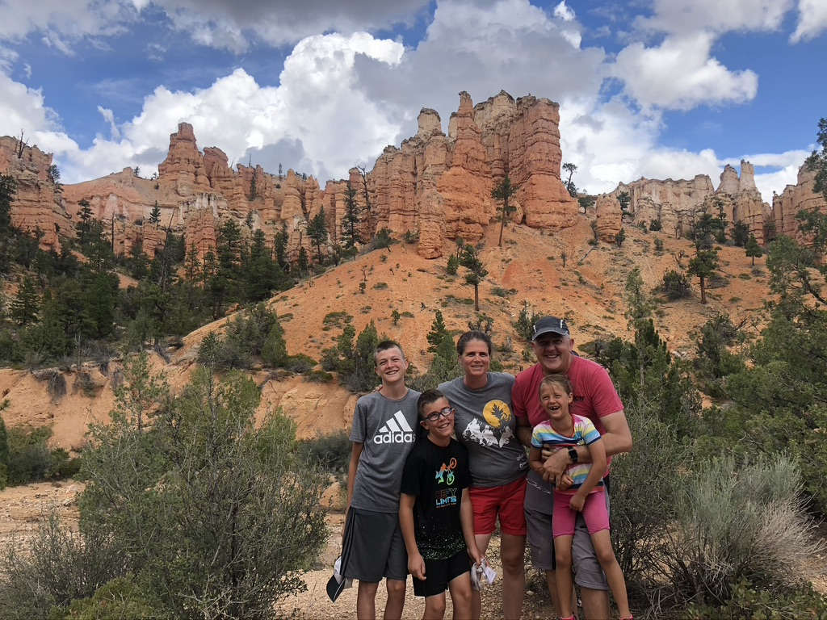
Family
Notes:
ASK: anybody knows where is this picture taken?

Slide 4




Occupation: Faculty in Software Engineering
Change is the heart of software development
Programming is program transformation
Q1: Analyze what software changes occur in practice?
Q2: How can we automate them?
Q3: Can we represent programs as transformations? Archive, retrieve, and visualize them?
Q4: Can we infer higher-level transformations?
Notes:
My research area is software engineering, and I specialize in software evolution.
In today’s world, software evolution is at the heart of any successful software. Successful software undergoes constant change. Typical changes are to add more features, fix bugs, improve performance, security, etc.
If we want to foster a revolution in software technology, similar with the industrial revolution, Change needs to move to a higher level of abstraction.
click
I envision a programming environment that places transformations at the center of software development, as first-class citizens.
My research addresses several important questions:
- what are the changes that occur most often in practice?
- and how can we automate them to improve the programmer's productivity and software quality?
Over the years my research team has been successfully automating three kinds of changes: upgrading library-based application to use the latest version of the library APIs on which they are based; updating obsolete tests to bring them in sync with the current version of the software; converting sequential code to parallelism so that the software runs efficiently on todays multicore machines. And upgrading mobile apps to improve responsiveness.
ASK: I am a contributor to the Eclipse, NetBeans, VisualStudio, and AndroidStudio development environments. Anybody here is using any of these IDEs?
---------
click
To turn this vision into reality, my research is driven by important questions:
- what changes occur most often in practice?
- how can we automate them to improve the programmer's productivity and software quality?
- Can we represent programs as sequence of transformations? How are we going to archive, retrieve, visualize such transformations?
- Can we infer higher-level transformations from lower-level changes, especially code edits?
Answering these questions is relevant and important for practice, as well as intellectually challenging and interesting
click
Our friend Mike, performs manually a few of his changes, then he creates a custom automated transformation, or better our environment infers his transformation and creates a custom automated transformation. Mike can reuse this transformation on the Brazilian code base, even though this code bases uses completely different names for the code elements.
click
-even manual edits become program transformations and are grouped and represented at a higher-level of abstraction
click
-Because our novel environment promotes an orthogonal view of programs as a sequence of higher-level transformations, Carol can easily make sense of the new code base when she comes from vacation.

Slide 5
Work in Your Strength Zone but Reinvent Yourself
Mobile [’13 - ’18]
-add async
-fix async
-privacy
Parallelism & Concurrency
[’08-’13]
Refactoring
- make thread-safe
- improve throughput
- improve scalability
GenAI [’23– TBD]
- LLM+IDE
Library migration [’02-’07]
- upgrade APIs
programs
IoT and ML [’19–’24]
-from deterministic to probabilistic
Principles for changing between different programming models
Notes:
Many times, people might tell you that you need to be good at everything: The truth is that you cannot be an expert on everything, you need to know a little about everything (so that you can see connections) but focus on the area that you are passionate about and you are good at (I call this the strength zone). Spend most of your time and energy in that area, do not attempt to be good at everything, because then you will be average and mediocre at everything.
This is my personal story of working on refactoring. I’ve been working on refactoring for 20 years.
When I meet people at the conferences, they ask me about my current work, and I tell them that I still work on refactoring. They ask me: Danny, Don’t you get bored working on the same refactoring topic?
<CLICK> During my 5 years of PhD I worked on Upgrading library-based applications to use the latest API of their libraries, even when these APIs were refactored. In this stage I learned about static program analysis and learned the Eclipse refactoring engine so well that I became a contributor to Eclipse.
<CLICK> Just as I was finishing my PhD in 2007, the world of computing was completely shaken up when Intel stopped producing single processor systems, and went into multicore.
So my interest shifted towards refactoring existing sequential programs to make them run in parallel, make programs thread-safe, and refactorings to improve the scalability of already parallel programs
This new world forced me into much deeper program analysis than I have done before.
<CLICK> But just about when I started to get comfortable with parallelism, the world changed again. People stopped buying laptops and everyone was on mobile devices. So I took what I learned from the parallelism domain, and adapted it to the new challenges of working with event—driven apps.
<CLICK>: now I am making the transition to yet another big domain: the digitalization of our world with IoT and how the sensors around us will collect information about us and the world that will augment our intelligence. In this new paradigm, how do we refactor existing programs that use deterministic algorithms into programs that use probabilistic computation and ML and continuously learn?
Key lesson that I learned: many times I ventured beyond refactoring into other areas (like HCI or Compilers) that were not my strenghts. I kept failing over and over until I learned to partner with others who were strong in the areas I was weak.
CLICK
I decided to stay and work in my strength zone: principles for refactoring programs between significantly different programming models, both in terms of the control-flow (from synchronous to callback-based, from sequential to parallel) and program state (from stateful to stateless execution, and from shared- to distributed- memory style of communication)
But at the same time I keep an eye open on big changes in the field of computing, and I am reinventing myself every 5 years. This way I remain fresh and keep learning while I stay in my strength zone
==
Gesture: stand in the middle and point at the screen at the different areas.

Slide 6





My dream: Practical Impact on SW Development
Automating
Inferring
- used at
- dozen labs
-ship with official
Refactoring
- hundreds of
accepted patches
founded Workshop
on Refactoring Tools,
HotSwUp, Dagstuhl S.
- first open-source
refactoring
Understanding
- shaped APIs in Java and .NET official concurency libraries
-learnparallelism.net 150,000+ visitors
Testing
Notes:
Here is another teachable moment for you as students.
Identify your Dream.
What do you want. What do you really, really want?
Do you want to publish papers? Do you want to have lots of citations?
My dream for me is making a practical difference in the life of real software developers.
CLICK
For example, several of our refactoring tools ship with the official release of IDEs such as Microsoft Visual Studio, NetBeans, Eclipse, AndroidStudio which are used daily by millions of software developers
CLICK
Using our tools, we generated hundreds of change patches that were accepted in famous open source projects such as Apache foundation such as Cassandra which is used for big data processing in every single Fortune-500 company.
CLICK
Several years ago I developed the world’s first open-source refactoring engine for Java
CLICK
The work on inferring API-level refactorings is used at Google, IBM, and dozens of labs
CLICK
Some of our testing work has been integrated in the testing infrastructure of the NETBEANS IDE at Oracle
CLICK
moreover, the formative studies that we conducted to reveal misuse, underuse, and abuse of parallel constructs has already shaped APIs in Java and .NET official concurrency libraries
Some of the educational resources that we developed, have already received hundreds of thousands of visitors
CLICK
I am not telling you all this to impress you, but to impress upon you that it takes a mindset and dedication to identify what’s your dream and to pursue it. None of these adoption in industry have happened by chance, by publishing papers and then hoping that one day somebody in industry finds them. I was proactively pursuing industrial collaborations.
You might think that sometimes publishing papers is going in the opposite direction to your dream. I am learning how to make academic papers serve my dream by going the extra mile to move research into practice.

Slide 7
Recreation

Slide 8
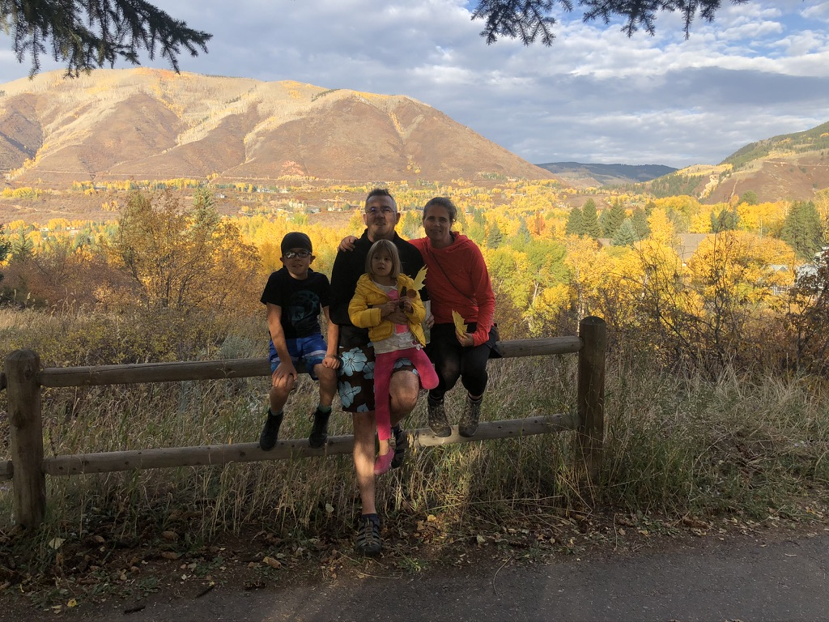
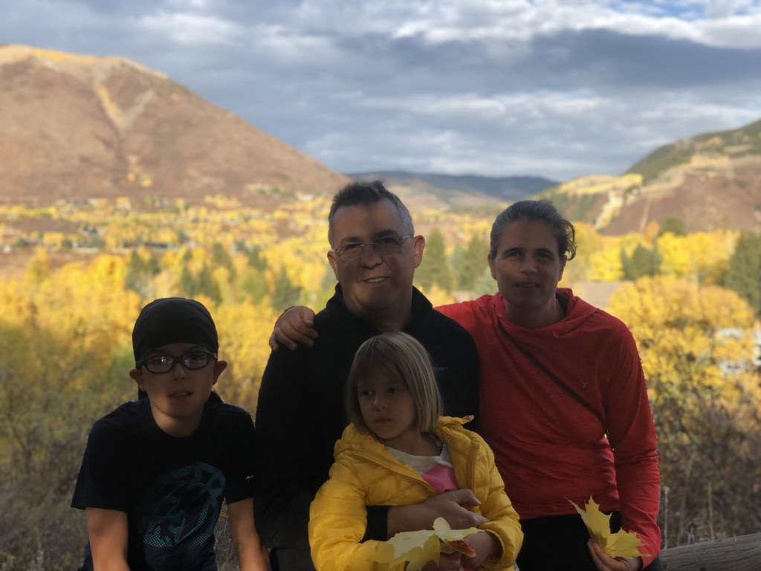
Recreation
Notes:
ASK: anybody knows where is this place?
Aspen CO.

Slide 9

Recreation
Notes:
ASK: anybody knows where is this place?
This was a year ago in the week between Christmas and NY, at Copper Mountain. This year since we did not get enough snow in Colorado, we went skiing with my whole family to Utah.

Slide 10
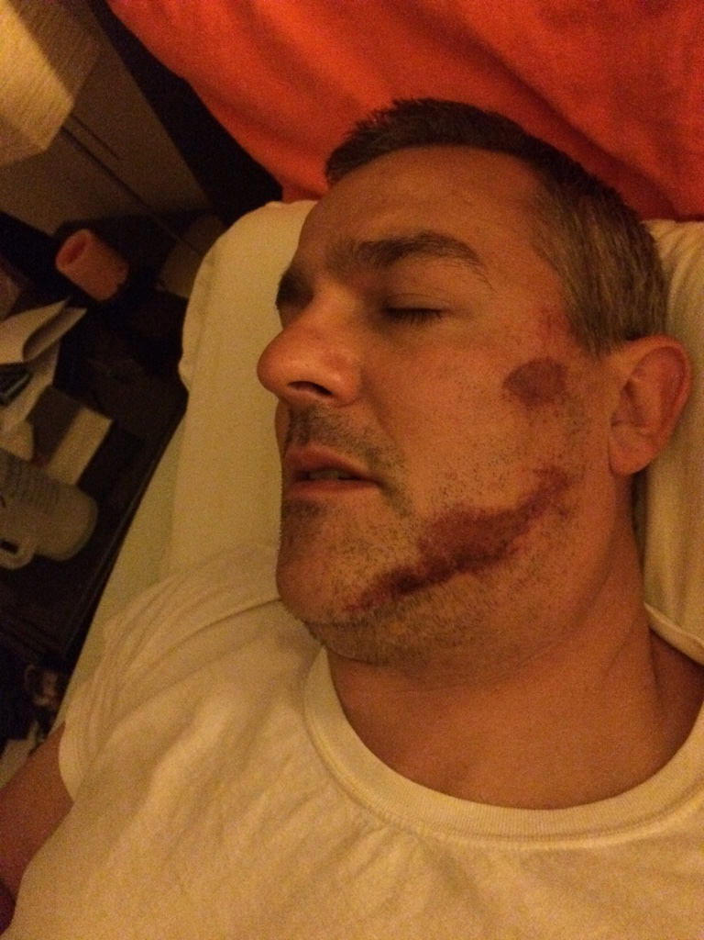
On Aug 5, 2015 …
From personal success to significance
From a ladder climber to a ladder holder
Notes:
One day, I opened my eyes and found myself in a strange place, stranded on a white bed, in a white room.
On the wall in front of me was a whiteboard on which was written: Today’s date is Aug 5th, 2015, this is the Good Samaritan Hospital in Corvallis Oregon.
I asked a person in white why I am there, and she told me that I had a <CLICK>bicycle crash.
I did not remember any accident, I no longer remembered what year it was, or how many children I had or what was their birthday. I was happy to recognize my wife. Note to self: when something back happens, make sure that you remember the people closest to you.
When she came to my bed I kept asking her: <CLICK BACK> honey where I am and why I am here.
She told me the same story: I crashed my bicycle <CLICK FORWARD>. A minute later I would ask again <CLICK BACK> "honey where I am and why I am here", and my patient wife kept telling me the same answer <CLICK FORWARD> .
<CLICK FORWARD> You see, I had suffered a severe brain concussion in which I lost my short term memory, so my memory was resetting every 2 minutes.
<CLICK> The days and months after my accident I reflected on my life. While my brain was foggy from loss of short term memory, I had the best clarity of mind and I was seeing the big picture. I saw how selfish I was, and while being very successful in academia, I was using people to serve me.
For example, I was focusing on the research that the students was producing and less on the students. I was the proverbial farmer who cared more about the golden egg than about the golden hen.
I decided to turn my life around, and decided it was time for me to serve people, instead of waiting to be served.
Everyday I am learning how to intentionally serve people and add value to others.
Everyday I am learning how to shift from being a ladder climber to being a ladder holder. I want you to reach higher than I did, to go further than I did.
I shifted from being preocupied by my own success to mentoring more junior faculty so that they can learn and avoid the mistakes I made.
I will give you unprecedented access to behind-the-curtain information on how I do research;
Some of these are brand new insights that I have never shared before. So when you see the Owl icon, I am about to share one of those insights.
I am So excited to share these with you.
===
Notice: don’t talk

Slide 11

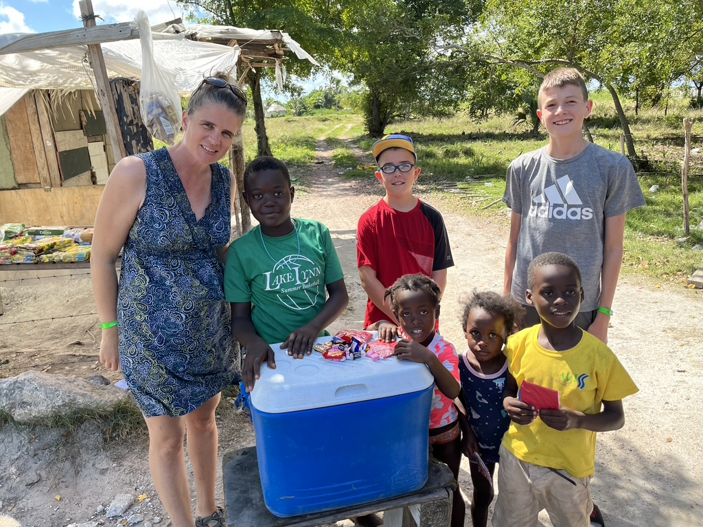
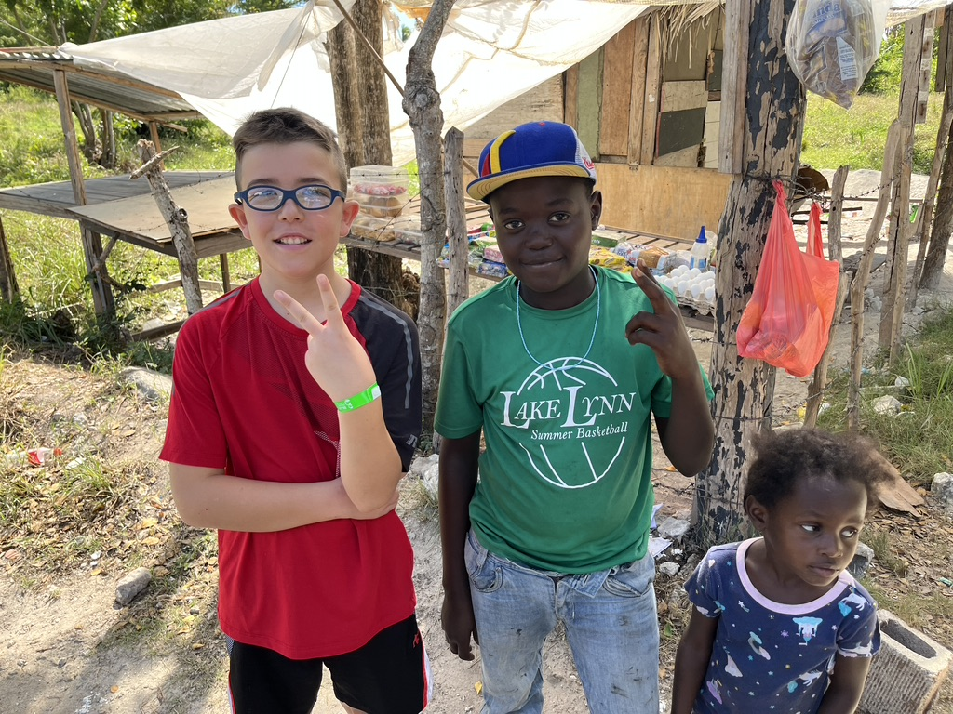
Motivation
Notes:
In 2021 I went on an extended trip to the Dominican Republic with my mentor John Maxwell (the #1 leadership expert in the world) and 200 of our leadership coaches. The DR president invited us to start a leadership transformation for the whole nation. I am so grateful that we trained 37,000 leaders from all major streams of influence (government, business, education, non-profits, sports, media, health, etc.). I came home also transformed and with a renewed sense of gratitude for everything we have at home.
CLICK I want to share with you a personal story that changed my perspective. As my family joined me for this extended trip in the DR, one day we stopped by on the side of the road to help some local kids that were making a living by selling cold water and basic staple foods. We came prepared from home with candies and small toys to share, and my 3 children got to experience the joy of helping some less fortunate kids from the DR. We were about to leave, when the older DR boy pointed to my son's hat. Even though we could not communicate with him, we knew that he really liked that hat. Before I tell you what happened next, you need to understand the story behind this hat. My son Alek and I love downhill mountain biking. We spent a memorable weekend in 2020 at our favorite downhill bike park, Trestle Bike Park in Winter Park Colorado. At the end of the weekend I asked my son what I can buy him so that he would always remember our special weekend. My son asked me for a hat with the Trestle Bike Park logo. He has been wearing this hat every single day of his life ever since summer 2020. He's been wearing it outside of the house. He has been wearing it inside of the house. Summer and Winter, Spring, and Fall. Day and night. He only takes it off when he goes to sleep. When the DR kid asked Alek for his hat, my son took it off.
<CLICK> My family asked him if he really wanted to give it to the DR kid, and my son said absolutely yes. My heart filled with joy and my eyes filled with tears when I saw Alek's act of kindness. Giving away the candies and the toys was no sacrifice for Alek, because I was the one who bought them. But giving away his most valuable possession was a true sacrifice. You can see the happy smile on his face, and how much his gift meant to the DR kid. I was so grateful that Alek understood at age 10 that in life we are more happy when we give than when we receive.

Slide 12
Discussion Roadmap
1. Surprise Insights — 5–7 min
2. Models, Data, Gaps — 10–12 min
3. Optimization & Hybridization — 10 min
4. Evaluation & Non-determinism — 10–12 min
5. Tasks & Future Directions — 15 min
6. Hallucinations: reducing techniques
7. Breakout room activity

Slide 13
1. First Reactions & Surprise Insights (5–7 min)
Notes:
What was the most surprising finding from these two surveys?
Did any result contradict your expectations (e.g., dominance of decoder-only models, underrepresentation of design/requirements)?
Which SE task/domain did you expect to be more mature than it is, and why do you think it’s lagging?

Slide 14



Do not edit How to change the design
What was the most surprising finding from these two surveys?
The Slido app must be installed on every computer you’re presenting from

Slide 15
Do not edit How to change the design
Did any result contradict your expectations?
The Slido app must be installed on every computer you’re presenting from

Slide 16
Do not edit How to change the design
Which SE task/domain did you expect to be more mature?
The Slido app must be installed on every computer you’re presenting from
Notes:
Which SE task/domain did you expect to be more mature, and why do you think it’s lagging?

Slide 17
2. Models, Data, and Practice Gaps (10–12 min)
Why are decoder-only LLMs dominating SE tasks? What do we lose by underusing encoder(-decoder) models?
Only 6/395 studies used industrial datasets. How does this bias research?
Should SE research prioritize lighter SE-specific LLMs over mega-models?
YourQ: How do the fundamental architectural differences between encoder, decoder, and encoder- decoder models dictate their suitability for distinct SE tasks like code generation versus understanding?
Notes:
Model trends: Why are decoder-only LLMs dominating SE tasks? What do we lose by underusing encoder(-decoder) models?
Data: Only 6/395 studies used industrial datasets. How does this bias research, and how might academia–industry collaborations help?
Sustainability: Should SE research prioritize lighter SE-specific LLMs over general mega-models?

Slide 18
Model Architectures for SE Tasks
🔹 Encoder-only (BERT, RoBERTa) • Strength: Understanding, classification, embeddings • SE Use: Bug detection, code search, clone detection, traceability
🔹 Encoder–Decoder (T5, CodeT5) • Strength: Sequence-to-sequence transformations • SE Use: Code translation, doc generation, refactoring, test generation
🔹 Decoder-only (GPT, CodeX, Code Llama) • Strength: Generative, autoregressive, few/zero-shot • SE Use: Code completion, repair, requirement-to-code, design brainstorming
✅ Rule of Thumb:
Understanding → Encoder
Transformation → Encoder–Decoder
Generation → Decoder

Slide 19
3. Optimization, Prompting, and Hybridization (10 min)
When would you choose Prompt engineering (few-shot, COT) vs. PEFT (LoRA, adapters, fine-tuning).
Hybrid pipelines: What’s the most promising way to combine LLMs with traditional SE tools (static analysis, testing, formal methods)?
Notes:
When would you choose prompt engineering (few-shot, zero-shot, CoT) vs. PEFT methods (LoRA, adapters, prefix tuning)?
Hybrid pipelines: What’s the most promising way to combine LLMs with traditional SE tools (static analysis, search-based testing, formal methods)?

Slide 20
4. Evaluation, Non-Determinism, and Ground Truth (10–12 min)
Are current metrics (BLEU, Pass@k, F1, MRR) missing key dimensions (security, maintainability)?
Unlike natural language, code can be executed/tested. Should execution-based validation be mandatory?
Non-determinism: Only ~20% of surveyed papers treat non-determinism as a threat. Should standards require multiple runs?
YourQ: How to achieve the trustworthiness required for deploying LLM-generated code in mission-critical systems? How to assesses deeper qualities like efficiency and security? What level of verification from such a system would be required for confident adoption?
Notes:
Metrics are fragmented: BLEU, Pass@k, F1, MRR… Which dimensions are missing (security, maintainability, readability)?
Unlike natural language, code can be executed/tested. Should execution-based validation be mandatory for LLM4SE research?
Non-determinism: Only ~20% of surveyed papers treat it as a threat. Should reproducibility standards require multiple runs + statistical testing?

Slide 21
5. Tasks, Domains, and Future Directions (15 min)
Current focus: ~71% generation, ~57% dev tasks. What would it take to push LLMs into requirements/design/management?
Where do you see the next big win for LLM4SE (program repair, test generation, traceability)?
How can SE methods (testing, maintainability) help build better LLMs (SE4LLM)?
If you could extend these surveys in one year, what new themes do you expect to explode?
Notes:
Current focus: ~71% generation, ~57% dev tasks. What would it take to push LLMs into requirements, design, or management (≤5%)?
Where do you see the next big win for LLM4SE (e.g., program repair, test generation, traceability, refactoring)?
SE4LLM: How can SE methods (testing, maintainability, modularity) help build better LLMs?
If you could extend these surveys in one year, what new themes do you expect to explode (e.g., agents, IDE integration, safety, human–AI collaboration)?

Slide 22
Hallucinations in LLM4SE: The Challenge
LLMs generate plausible but incorrect code/specs.
High-risk in security patches, effort estimation, API migration.
When are hallucinations tolerable vs. unacceptable?
Notes:
Framing (2 min)
LLMs sometimes generate plausible but wrong code, design specs, or requirements.
In SE, hallucinations can be more damaging than in natural language (e.g., a small mistake in security patch code).
Both Hou et al. (2024) and Fan et al. (2023) highlight hallucinations as a barrier to adoption.
Discussion Prompts (6–8 min)
Where do hallucinations matter most?
Which SE domains can tolerate some hallucinations (e.g., brainstorming, idea generation)?
Which domains require zero tolerance (e.g., security patches, effort estimation)?

Slide 23
Reducing Hallucinations: Techniques & Hybrid Approaches
Static analysis: type safety, detect inconsistencies.
Dynamic analysis: unit tests, fuzzing, execution traces.
Search-based: multiple candidates, filter via constraints.
Hybrid workflows: LLM + checks + human-in-the-loop approval.
Notes:
Detection and Reduction Techniques:
What hybrid methods could help verify LLM output?
Static analysis (check compilation, type safety, data flow consistency).
Dynamic analysis / execution traces (test cases, fuzzing).
Search-based methods (generate multiple candidates and validate).
Human-in-the-loop workflows (ask devs to approve/refine suggestions).
Which of these are most practical in real-world developer workflows?
Design an Anti-Hallucination Pipeline:
Imagine you’re building a code assistant for refactoring or requirements traceability.
How would you architect the pipeline to minimize hallucinations (LLM output → static checks → filtered candidates → developer confirmation)?

Slide 24
Your Miscellaneous Questions
The Human-Developer Interaction and the Future of SE Roles
As the software engineer's role evolves due to AI integration, what are the concurrent psychological impacts on developers and the long-term risks of skill atrophy, and how can we proactively design optimal human-in-the-loop workflows and truly collaborative IDEs that augment developer expertise rather than simply replacing it?
Bridging the Gap Between Research and Industrial Practice
What practical strategies and model transferability benchmarks are needed to bridge the gap between academic research on clean, open-source data and the complex reality of industrial software engineering, considering the primary adoption barriers of model size, inference latency, and the costs of adapting to proprietary, mixed-language monorepos?
Notes:
Framing (2 min)
LLMs sometimes generate plausible but wrong code, design specs, or requirements.
In SE, hallucinations can be more damaging than in natural language (e.g., a small mistake in security patch code).
Both Hou et al. (2024) and Fan et al. (2023) highlight hallucinations as a barrier to adoption.
Discussion Prompts (6–8 min)
Where do hallucinations matter most?
Which SE domains can tolerate some hallucinations (e.g., brainstorming, idea generation)?
Which domains require zero tolerance (e.g., security patches, effort estimation)?

Slide 25
Your Miscellaneous Questions – part 2
Governance, Liability, and Regulation
For high-stakes regulated industries, what would a comprehensive governance framework entail, integrating both clear legal models for liability and accountability when AI-generated code causes harm, alongside the necessary technical and procedural mechanisms—such as code lineage tracking and automated audits—required to ensure and prove compliance?
Prompting and Fine-Tuning Techniques
To move beyond ad-hoc methods of controlling LLMs, what are the precise technical distinctions, costs, and performance trade-offs between prompt engineering and Parameter-Efficient Fine-Tuning (PEFT), and is it feasible to develop a formal, standardized framework to make the prompt creation process more deterministic and reliable?
Notes:
Framing (2 min)
LLMs sometimes generate plausible but wrong code, design specs, or requirements.
In SE, hallucinations can be more damaging than in natural language (e.g., a small mistake in security patch code).
Both Hou et al. (2024) and Fan et al. (2023) highlight hallucinations as a barrier to adoption.
Discussion Prompts (6–8 min)
Where do hallucinations matter most?
Which SE domains can tolerate some hallucinations (e.g., brainstorming, idea generation)?
Which domains require zero tolerance (e.g., security patches, effort estimation)?

Slide 26
Your Miscellaneous Questions – part 3
Hallucinations: A Risk or an Opportunity?
How can development teams manage the duality of LLM hallucinations by establishing criteria to identify rare, beneficial suggestions (like novel test cases) while simultaneously implementing robust training and evaluation strategies to mitigate the significant risk of developers blindly accepting harmful, bug-inducing fabrications?
Critique of the Systematic Literature Review (SLR) Methodology
How can the Systematic Literature Review methodology be modernized to improve its comprehensiveness, both by replacing questionable heuristics like page-length filtering with advanced AI-driven discovery methods like vector search, and by adapting its scope to formally include innovation from non-traditional research sources like industry blogs and open-source forums?
Notes:
Framing (2 min)
LLMs sometimes generate plausible but wrong code, design specs, or requirements.
In SE, hallucinations can be more damaging than in natural language (e.g., a small mistake in security patch code).
Both Hou et al. (2024) and Fan et al. (2023) highlight hallucinations as a barrier to adoption.
Discussion Prompts (6–8 min)
Where do hallucinations matter most?
Which SE domains can tolerate some hallucinations (e.g., brainstorming, idea generation)?
Which domains require zero tolerance (e.g., security patches, effort estimation)?

Slide 27
Breakout Activity: Underserved SE Domains
Domains: Requirements, Design, Refactoring, Management.
Step 1 – Pick a task in your assigned domain.
Step 2 – Propose 3 evaluation metrics.
Step 3 – Address hallucinations in your domain.
Step 4 – Address non-determinism in your domain.
Step 5 – Share a 1-sentence summary of task + metrics.
Notes:
Step 1 – Assign domains (1 min): Divide the class into 3–4 groups, each focusing on one underexplored SE activity:
Requirements engineering (e.g., ambiguity detection, traceability)
Software design (e.g., rapid prototyping, specification synthesis)
Refactoring / Maintenance (e.g., rename refactoring, API migration)
(Optional 4th group) Software management (e.g., effort estimation, tool configuration)
Step 2 – Group task (6–7 min): Each group answers:
Task focus: Pick one specific SE task in your domain that could benefit from LLMs.
Example: For requirements → detecting ambiguity in natural language requirements.
For design → generating candidate UML diagrams from textual specs.
For refactoring → suggesting consistent renames across a codebase.
Evaluation framework: Propose 3 evaluation measures that matter for this task.
Requirements: precision/recall on ambiguity detection, stakeholder satisfaction in a user study.
Design: structural correctness of UML, design coverage, human-judged usability.
Refactoring: correctness of semantic preservation, naming consistency, developer adoption.
Non-determinism: How would you test multiple LLM outputs (reruns, majority voting, human-in-the-loop)?

